Slide 1
Oura Ring Analysis
with Python
Kevin Anderson
4/28/2023

Slide 2
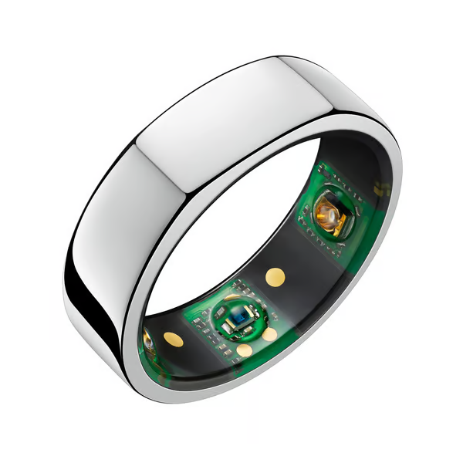
Introduction
Objective: Analyze relationships between daily activity, sleep efficiency, and readiness scores using the Oura Ring
The Oura Ring: Wearable device tracking sleep, activity, and readiness metrics
Approach: Use Python libraries and Streamlit for interactive data visualization and understanding insights.

Slide 3
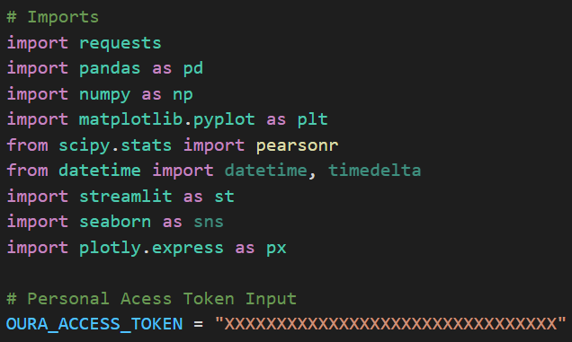
Imports and Access Token
Importing required libraries and tools for data manipulation, analysis, and visualization
Obtaining personal access token for secure data retrieval from the Oura API

Slide 4
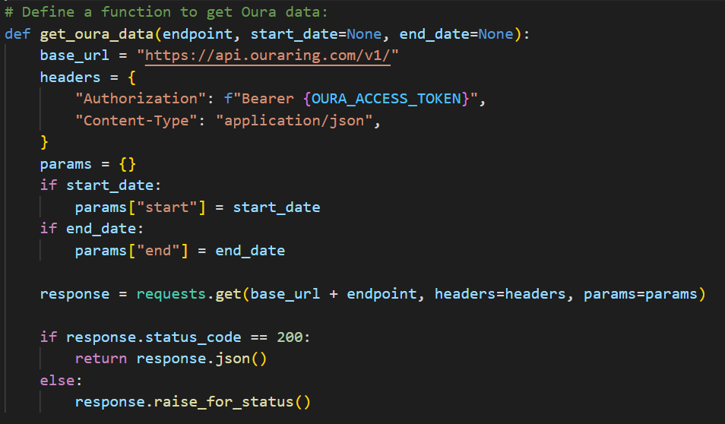
Data Retrieval Functions
Developing functions to collect sleep, activity, and readiness data
Utilizing the Oura API to retrieve user-specific data

Slide 5
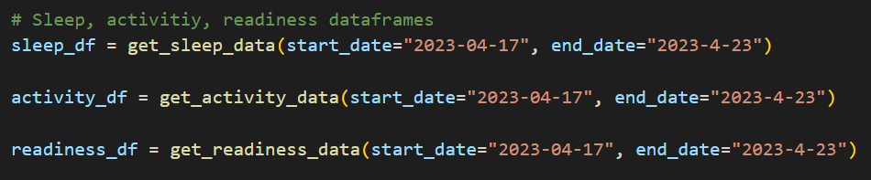
Data Processing
Merging sleep, activity, and readiness data into a comprehensive DataFrame
Analyzing data from a specific date range
Facilitate deeper understanding of user’s health and wellness patterns

Slide 6
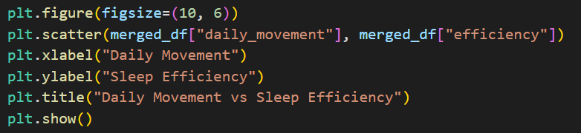
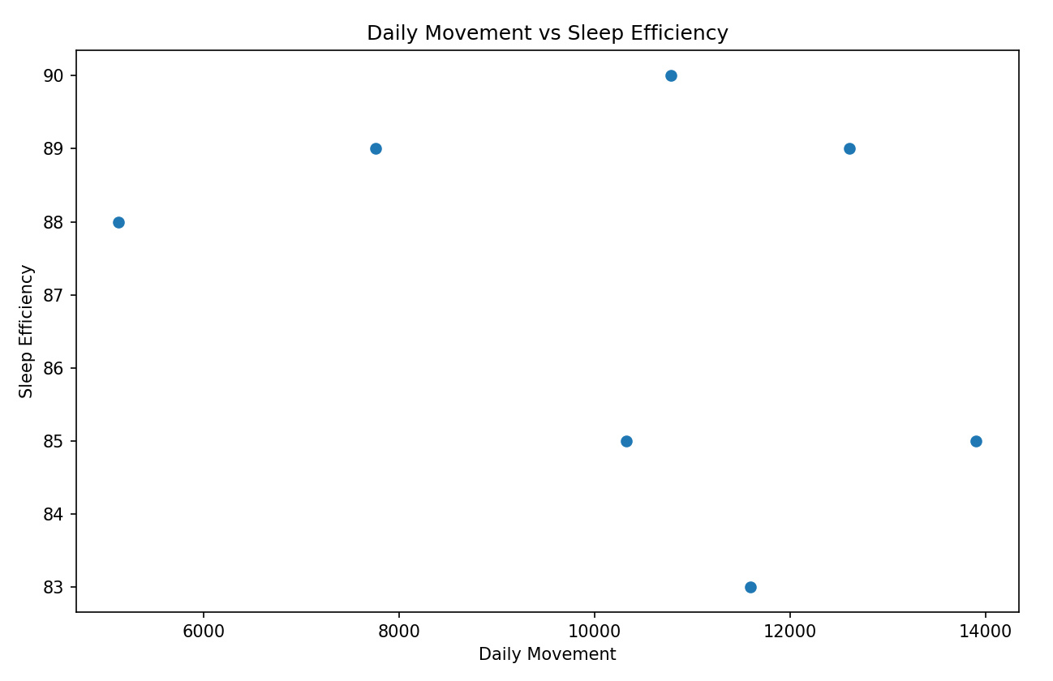
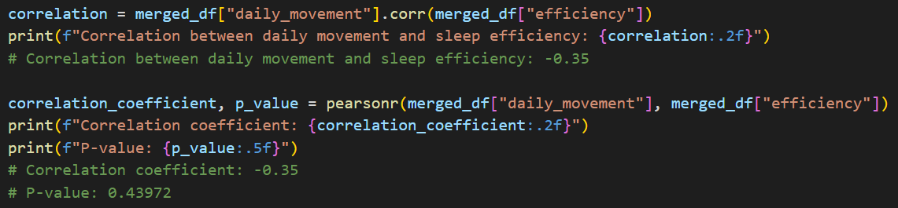
Hypothesis Testing -
Activity and Sleep Efficiency
Hypothesis (H1): There is a negative correlation between daily movement and sleep efficiency.
Null Hypothesis (H0): There is no correlation between daily movement and sleep efficiency.
Correlation coefficient: -0.35, p-value: 0.43972
Result: Fail to reject H0, suggesting a weak negative correlation between daily movement and sleep efficiency, but not significant enough to confirm the hypothesis.

Slide 7
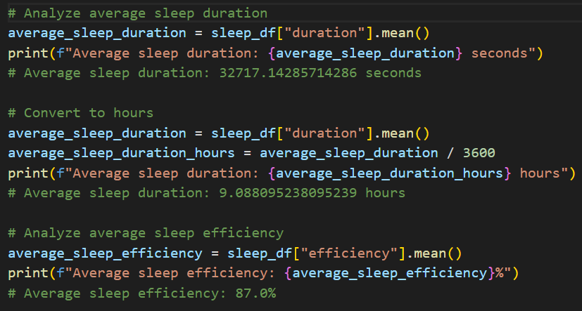
Average Sleep Duration and Efficiency
Analyze average sleep duration and sleep efficiency
Calculating average sleep duration: 9.09 hours
Assessing average sleep efficiency: 87%
Insights into user’s sleep patterns and quality

Slide 8
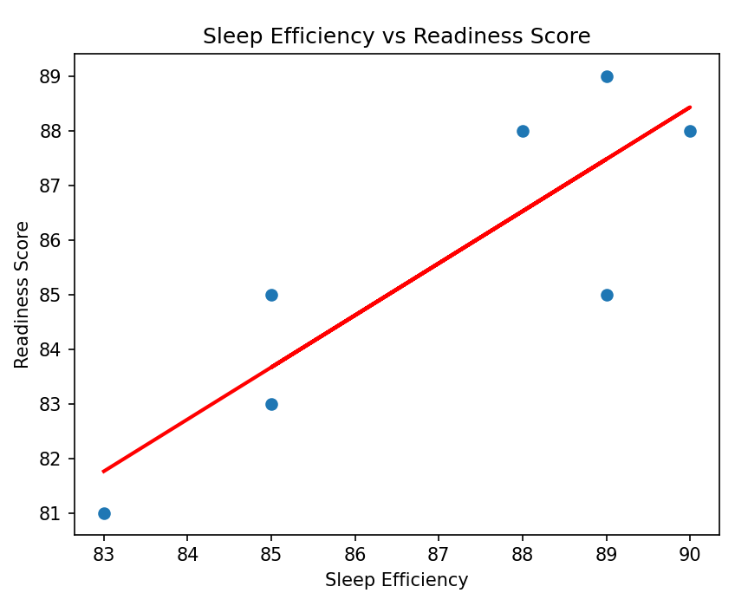
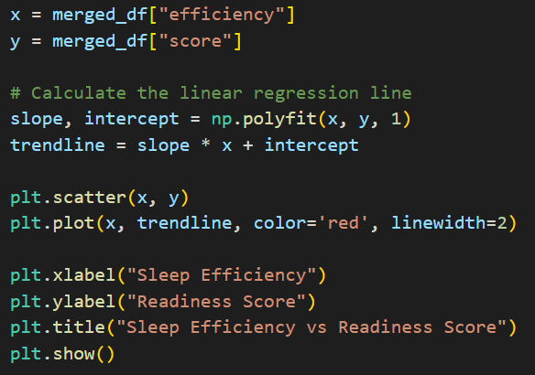
Hypothesis Testing -
Sleep Efficiency and Readiness Scores
Hypothesis (H2): There is a positive correlation between sleep efficiency and readiness scores.
Null Hypothesis (H0): There is no correlation between sleep efficiency and readiness scores.
Correlation coefficient: 0.86, p-value: 0.01343
Result: Reject H0, suggesting a significant positive correlation between sleep efficiency and readiness scores.

Slide 9
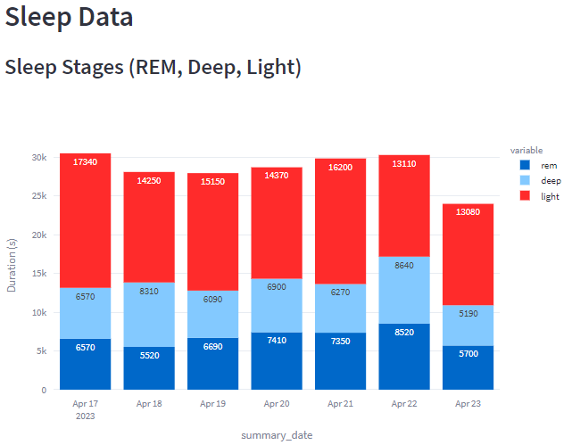
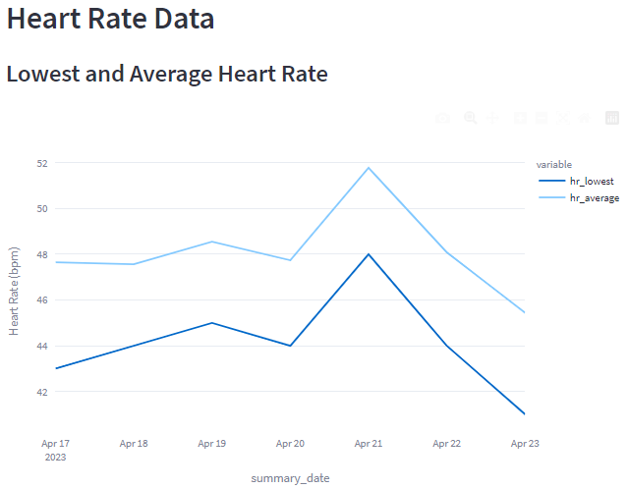
Streamlit App - Interactive Visualization
http://localhost:8501/
Developing a Streamlit app for interactive data visualization
Simplifying data presentation for non-technical users
Engaging users with data insights through a user-friendly interface for health improvements

Slide 10
Conclusion
Observed weak negative correlation between daily movement and sleep efficiency, suggesting that higher daily activity levels do not necessarily lead to better sleep quality.
Found strong positive correlation between sleep efficiency and readiness scores, indicating that better sleep quality can improve overall well-being and preparedness for the day.
Average sleep duration of approximately 9.09 hours and average sleep efficiency of 87% indicate overall good sleep quality for the user.
Insights can help users optimize daily activity levels and improve sleep quality to enhance overall well-being.
The analysis demonstrates the utility of wearable devices like the Oura Ring in tracking health and wellness metrics.
Streamlit app enables effective data presentation and exploration, providing valuable insights for users and stakeholders, and making it easier for them to understand the value of the Oura Ring and its potential impact on health and wellness.
Future research could explore additional factors that influence sleep efficiency, readiness scores, and daily activity levels to provide a more comprehensive understanding of the user's health and wellness patterns.

